Slide 1
Week 1

Slide 2

Math Corner - Monday
A customer wants the baker to make two tenths of a cake vanilla, four tenths chocolate, and the rest strawberry. How much of the cake will be strawberry? Show your thinking in words and models.
Review…
Lincoln Elementary School had a jump rope contest. Nancy jumped 304 times. Jason jumped 197 times. What is the best estimate of how many more times Nancy jumped than Jason?

Slide 3
Math Corner-Tuesday
If I gave 4/10 of a candy bar to my friend and ate 2/10 of the same bar, how much of the candy bar is left? Show your thinking in pictures, words, or numbers.
Number Talk…
Solve mentally using place value.
99 + 38
98 + 47
98 + 99
99 + 99 + 5

Slide 4
Math Corner-Wednesday
Solve with pictures, words, and number
sentences. Corey ordered this pizza from
Papa John’s. She ate a slice, her brother ate
two slices, and their Dad ate two slice.
What fraction tells how much pizza is left?
What fraction tells how much pizza was eaten?
Review…
Lois bought a plane ticket for $757. Will bought a place ticket for $473.
How much did they spend altogether?
How much more did Lois spend than Will?

Slide 5
Math Corner-Thursday
Don wants to eat ONE HALF of a candy bar. Callie wants to eat an equivalent amount, but she wants to cut it into fractional parts in a different way. How can she do this?
Number Talk…
Solve mentally using place value.
116 + 29
39 + 127
114 + 118
46 + 118

Slide 6

Math Corner-Friday
The fraction is two fourths. Can you show this fraction…
As part of a set
As part of a whole
On a number line
As an equivalent fraction
Review…
There are 12 students in the writing club. Each student has a pen pal in another country. This year, each student will write 7 letters to their pen pal. How many letters will the writing club write to pen pals this year? Explain how you found your answer.

Slide 7
Week 2

Slide 8
Monday Cory and Allison have the same size poster board to use for a project. They each divided their poster boards into equal parts as shown. Cory’s Poster Board Allison’s Poster Board Part A Write a fraction to represent the size of one part of Allison’s whole poster boar. Explain how you got your fraction. Part B Allison says that two parts of her poster are equal to one part of Cory’s poster. Use what you know about equivalent fractions to explain or show if Allison is correct. Part C Cory and Allison both colored 3 parts of their posters blue. Cory says that they colored equal parts of their posters. Is Cory’s statement correct? Use what you know about comparing fractions to explain your answer.

Slide 9
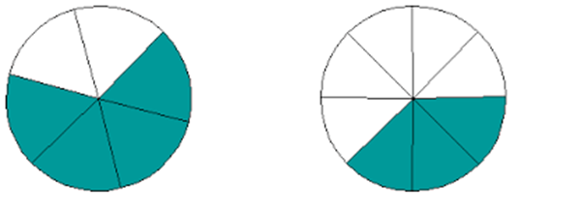
Tuesday
Ms. Barr drew two circles on the board. She split both circles into 6 equal parts. Then she shaded in some pieces on each circle.
Part A
Write the two fractions that the circles show. Use the symbol <, >, = to compare your fraction. Explain your answer.
Part B
Draw a circle with 6 equal parts that show a fraction that is greater that both of Ms. Barr’s

Slide 10
Wednesday
Constructed Response: Fractions Karina is painting a fence as shown. The fence is divided into equal parts. The shaded area represents how much of the fence Karina has painted. Part A Draw a number line from 0 to 1 and divide it into the same number of equal parts as the fence. Make a point on your number line that shows the fraction of the fence Karina has painted. Label the point with the fraction that it represents. Part B Write a fraction that represents the whole fence. Part C Tammy is painting a fence with the same area as Karina’s fence, but her fence is divided into 6 equal parts. She has painted 5 parts of her fence. Tammy says that she and Karina have painted equal fractions of each fence. Is Tammy’s statement correct? Explain and show how you know.

Slide 11

Thursday The figure shows a rectangle that has been divided into equal parts. Part A Draw a number line from 0 to 1. Divide the number line into the same number of equal parts as shown in the figure. Then, place a point on the number line to show what the value of the shaded part represents. Part B Write an addition sentence with a numerator of 1 that is equivalent to the fraction of the shaded parts shown. Part C Fill in the box with a <,>, or = sign. Explain your answer using a model. 3/4 3/8

Slide 12

Friday LeBron, Rita, and Samuel went to a circus. They saw that the floor of the circus tent was a large rectangle divided into equal parts. Part A Draw a rectangle and divide it into more than 3 equal parts. Shade one of the equal parts of your rectangle. Write a fraction that shows what part of the whole rectangle you shaded. Explain your answer. Part B Samuel counted twice as many elephants as tigers in the circus. He counted a total of 24 elephants and tigers in all. How many tigers did Samuel count? Show and explain how you got your answer. Part C One of the clowns wore a shirt with colored quadrilaterals. Rita said she like the red quadrilaterals that was not a parallelogram. Draw a shape that could represent the shape Rita liked. Part D LeBron paid $14 for his ticket and $6 per ticket for Samuel and Rita. What was the total cost of the tickets? Show your work.

Slide 13
Week 3
Review

Slide 14
Monday Jana put her train set on the top of a table. The table is 6 feet long and 4 feet wide, as shown. 6 feet 4 feet Part A What is the area of the table? Show your work and explain how you got your answer. Part B What is the perimeter of the table? Show your work and explain how you got your answer. Part C Jana needed more room for her train set. She set up another table next to the table shown. The new table is 4 feet wide and has a perimeter of 24 feet. What is the sum of the areas of the two tables together? Show your work.

Slide 15
Tuesday Look at the rectangle. 8 cm 5 cm Part A What is the area of the rectangle in square centimeters? Label your answer and show your work. Part B Draw a rectangle and divide it into 4 equal parts. What is the relationship of the area of one part to the area of the entire rectangle? Part C In square centimeters, what is the area of one of the parts from the divided rectangle in Part B? Show your work.

Slide 16
Wednesday Zack draws a square that has a length of 5 centimeters. Part A How can you determine the distance around the square? Show your work. Part B What is the area of the square? Show your work. Part C Zack draws a second square that is 8 centimeters long. Bella said the area and perimeter are the same. Do you agree? Show your work.

Slide 17
Friday Henry and Allison each baked a pasta pie. Henry’s pie was 9 inches long and Allison’s was 8 inches long. Each pasta pie was cut into 6 equal sections. Henry’s Pasta Pie Allison’s Pasta Pie Part A Henry gave one piece of his pasta pie to a friend. What fraction of his pasta pie did Henry give away? Explain your answer. Part B Allison also gave one piece of her pasta pie to a friend. Allison says that she and Henry both have the same amount of pasta pie left. Is Allison correct? Explain your answer.

Slide 18
Week 4
Review

Slide 19



Math Corner-Monday
How is a clock like a number line?
2. If I started doing my homework at 4:30 and finished at 6:00, how long did it take me to finish? Show how to solve this problem using a number line and one other way.
Extra Practice:
What time do the clocks read below:

Slide 20
Math Corner-Tuesday
Katie gets home from school at 3:15. She has an afternoon snack for 15 minutes, and does her homework for an hour. Then, she goes to soccer practice. What time does Katie leave home to go to soccer practice?
For Practice…
Christi has a 5 dollar bill. If she buys a chicken finger meal from Zaxby’s for $3.42. What will be her change?

Slide 21
Marcus is sorting paint jars into sets for art class. He needs a total of 48 paint jars. Each set of paints will have one jar of each color, as shown.
Part A
How many sets of paint can Marcus make in order to have a total of 48 paint jars? Show your work.
Part B
Abigail finds jars of purple and white paint to add to each set. If she adds 1 jar of purple paint and one 1 jar of white paint to each set in Part A, how many total jars of paint will Marcus and Abigail have? Show your work.
Part C
The teacher separates Marcus’s and Abigail’s paint jars into sets of 4 paint jars. Write an equation to show how many
equal sets

Slide 22
Math Corner-Wednesday
Copy and fill in the missing places on this schedule for the Stockbridge Movie Theater.
Movie | Start Time | End Time | Duration
Alvin and the Chipmunks | 12:00 | 1:45
The Smurfs | 1:50 |  | 2 hours
The Muppets | 4:00 | 5:15
The Lion King |  | 7:00 | 90 minutes

Slide 23
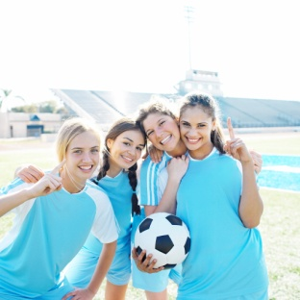
Math Corner-Thursday
Three hungry soccer teams need pizza. There are fourteen players on each team. If each pizza has ten slices, how many pizzas will the coaches need to buy for the team? Will there be any leftovers?
For Practice…
The last soccer game started at 5:45. Soccer games last for 1 hour and 20 minutes. What time did the game end?
Notes:
A discrete model has a set number of ways that the items can be separated. For instance, a bag of apples that has 10 apples can only be in tenths, fifths, or halves. A set of five balls can only be separated into fifths.

Slide 24
Math Corner-Friday
There are 47 tires at the tire shop. How many cars will get a new set tires? What does this mean for the tire shop? Solve with pictures, numbers, and words.
Review…
Draw a clock that shows the times below. 8:13, 2:24, 7:37, 5:59

Slide 25
Week 5

Slide 26

Math Corner-Monday
Survey your classmates with this question: “Which of these ice cream flavors is your favorite: chocolate, strawberry, or vanilla?” Construct a data table to record responses.
Think!
Wendy started biking at 2:35, and she rode for ½ an hour. Then, she cleaned her room for ¾ of an hour. What time was it when Wendy finished cleaning her room? Explain your answer.

Slide 27
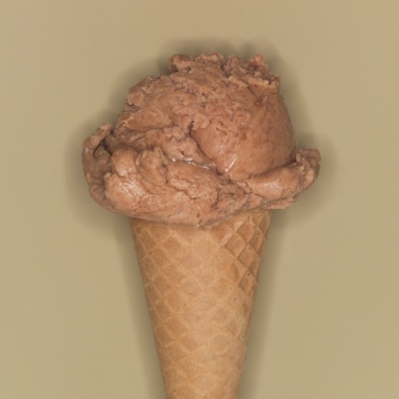
Math Corner-Tuesday
Use the data you collected yesterday (favorite ice cream flavor) to create a pictograph.
Think!
There will be 11 people at the pizza party. Each person will eat 2 slices. Pizzas will be cut into 8 slices. How many pizzas should Melissa order? Explain how you found your answer.

Slide 28
Extended Response
Sofia made a picture graph to show how the students in her grade get to school each morning.
Part A
How many walk to school? How can you prove your answer?
Part B
How many students were counted in this survey?
Part C
How many more students walk to school than ride the bus?

Slide 29

Math Corner-Wednesday
Create a bar graph with your favorite ice cream flavor data.
Think!
Stockbridge Elementary has a jump rope contest. Mrs. Simmons jumped 304 times. Mrs. Hodges jumped 197 times.
About how many more times did Mrs. Simmons jump than Mrs. Hodges?
Exactly how many times did they jump altogether?

Slide 30
Math Corner-Thursday
Mr. Young collected data to tell how many pictures students painted in art last week. He created the line plot below.
Most students painted how many pictures?
How many students painted less than 4 pictures?
How many students painted between 8 and 10 pictures?
        x
x x
x x x
x x x x
x x x x x x
x x x x x x x
x x x x x x x x
1 2 3 4 5 6 7 8 9 10
Think: Five friends plan to share the cost of a gift equally. The gift costs $24.45. What is the best estimate of the amount each friend have to pay?

Slide 31
Math Corner-Friday
Today, you will collect data for your line plot and add to it.
Create a table (like a t-chart) like the one to the right.
2. Survey your classmates and ask them, “How many pencils do you have in your desk?
3. Each time a classmate tells you how many, put a tally mark by that number on your chart. Remember, names do not matter for this type of graph.
4. Using your data, create your line plot.
5. Share your line plot with a classmate and ask them questions about your graph!
Think!
What number goes in the box to make the number sentence true?
(7 x 4) + 3 = + 3
Number of Pencils

Slide 32
Extra Review

Slide 33
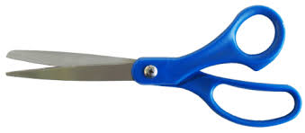
Monday
Alyssa has a rectangular wooden board. She cuts off 1/6 of the board from the left side and 2/6 of the board from the right side.
Part A
Draw a picture that shows 1/6 of the board shaded.
Part B
Draw a picture that show the total parts of the board that Alyssa cuts off.
Part C
Which is larger 1/6 or 2/6? Show how you know.
Part D
What fraction of the board does Alyssa have left?

Slide 34

Tuesday
Melissa travels 4 miles on her bike each day. Nadine travels 5 miles on her bike each day.
Part A
How many days will it take for Melissa to travel 100 miles on her bike? Prove your thinking.
Part B
How many days will it take for Nadine to travel 100 miles on her bike? Prove your thinking.

Slide 35
Wednesday
Carolyn collected some insects for a science project. The length, in inches, of the insects are listed below.
1/8, ¼, ¼, 5/8, ¾, 1/8, 3/8, 3/8, 5/8, 3/8, ¼
Make a line plot of the data. Include labels and a title.
What is another way to display your data? Explain your reasoning.

Slide 36
Thursday Dwight and Samantha are building brick towers as shown. The shaded parts show the number of bricks Dwight and Samantha each painted. Dwight Samantha Part A Write a fraction to show the part of the tower Dwight has painted. Write a fraction to show the part of the tower Samantha has painted. Part B Compare the two fractions using the symbols >, =, or <. Part B Each brick weighs 6 pounds. What is the total weight of each tower. How can you prove your thinking?

